Slide 1

DriverPass System Analysis
Karama Crager
Notes:
[No speaker notes required for this slide.]

Slide 2

System Requirements
Validate user credentials when logging in
schedule appointments made by users
Web-based system on the cloud
updatable at any point for new features
Notes:
[In your speaker notes, include an explanation of the different requirements you determined for DriverPass’s system. What are the functional requirements you selected to describe? What are the nonfunctional requirements you selected to describe? Be sure to explain how these requirements meet DriverPass’s needs.]

Slide 3
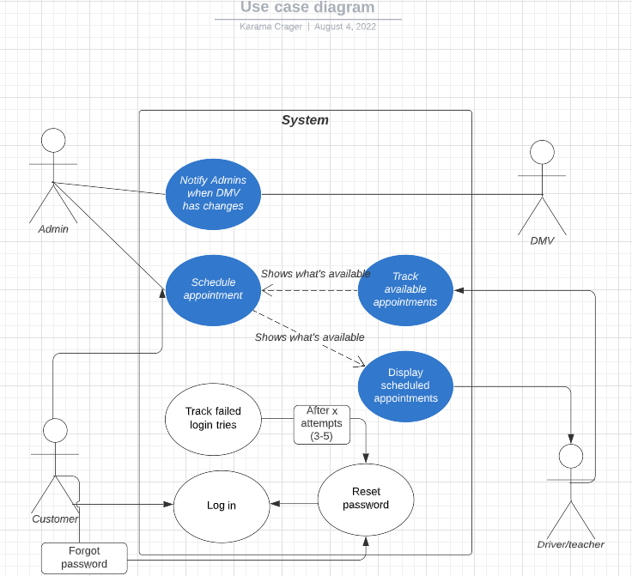
Use Case Diagram
Notes:
[Explain your diagram. Who are the different actors in the system? What are the different use cases? How did you account for DriverPass’s needs in your design? In your explanation, keep your audience in mind. Avoid the use of terms like “actors” and “use cases” in your explanation.]

Slide 4
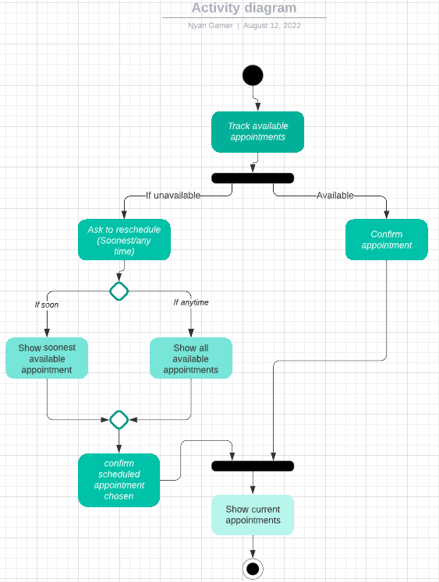
Activity Diagram
Notes:
[Explain your diagram. Which use case are you breaking down? What are the steps for this use case? How did you account for DriverPass’s needs in your design? In your explanation, keep your audience in mind. Avoid the use of technical terms such as “nodes,” “control flows,” and so on.]

Slide 5
Security
Validate Login
Admin’s role
Notes:
[How did you consider security in your design? In your explanation, keep your audience in mind by avoiding the use of technical terms.]

Slide 6
System Limitations
Update Profile
Payment method
Reschedule appointments
Internet connection
Downloadable content
Notes:
[What are the limitations of your design? In your explanation, keep your audience in mind by avoiding the use of technical terms.]

